Slide 1
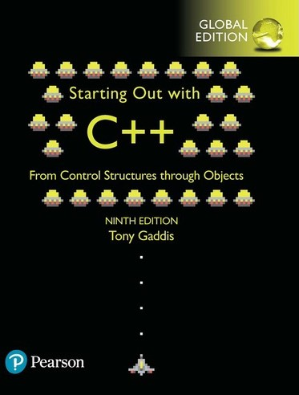

Topic 8 Recursion Dr. Mohammad Ali Sarvghadi
masarvghadi@usm.my

Slide 2
Topic 8
Recursion
Recursion

Slide 3
Introduction to Recursion
A function that calls itself is a recursive function.
void message()
{
cout << "This is a recursive function.\n";
message();
}

Slide 4
Introduction to Recursion (Cont.)
A function that calls itself is a recursive function.
void message()
{
cout << "This is a recursive function.\n";
message();
}
What is the problem with the function above?

Slide 5
Introduction to Recursion (Cont.)
A function that calls itself is a recursive function.
void message()
{
cout << "This is a recursive function.\n";
message();
}
What is the problem with the function above?
It acts like an infinite loop which leads the program to crash due to stack overflow.

Slide 6
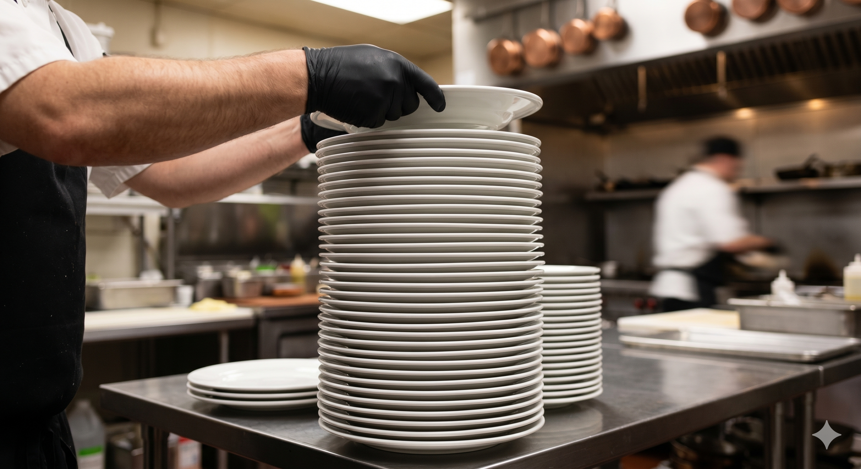
Stack Mechanism
The computer’s memory for recursive functions operates like a vertical stack of dishes.
It follows the Last-In, First-Out (LIFO) mechanism.
The last item pushed onto the stack is the first item to be popped (removed).
In recursive functions, each call pushes a new stack frame (containing the return address and local variables) onto the memory.
Because computer memory is finite, pushing frames infinitely leads to a Stack Overflow, the point where the "pile" hits the ceiling and crashes.

Slide 7
Introduction to Recursion (Cont.)
Solution
void message(int times)
{
if (times > 0)
{
cout << "This is a recursive function.\n";
message(times − 1); ← recursive call
}
} ← Control returns here from the recursive call, causing the function to return.

Slide 8
Introduction to Recursion (Cont.)
Code | Output
void message(int times) { cout << “Called with " << times << " in times.\n"; if (times > 0) { cout << “A recursive function.\n"; message(times − 1); } cout << “Returning with " << times; } Function call: message(5); | ???

Slide 9
Introduction to Recursion (Cont.)
Code | Output
void message(int times) { cout << “Called with " << times << " in times.\n"; if (times > 0) { cout << “A recursive function.\n"; message(times − 1); } cout << “Returning with " << times; } Function call: message(5); | Called with 5 in times. A recursive function. Called with 4 in times. A recursive function. Called with 3 in times. A recursive function. Called with 2 in times. A recursive function. Called with 1 in times. A recursive function. Called with 0 in times. Returning with 0 Returning with 1 Returning with 2 Returning with 3 Returning with 4 Returning with 5

Slide 10
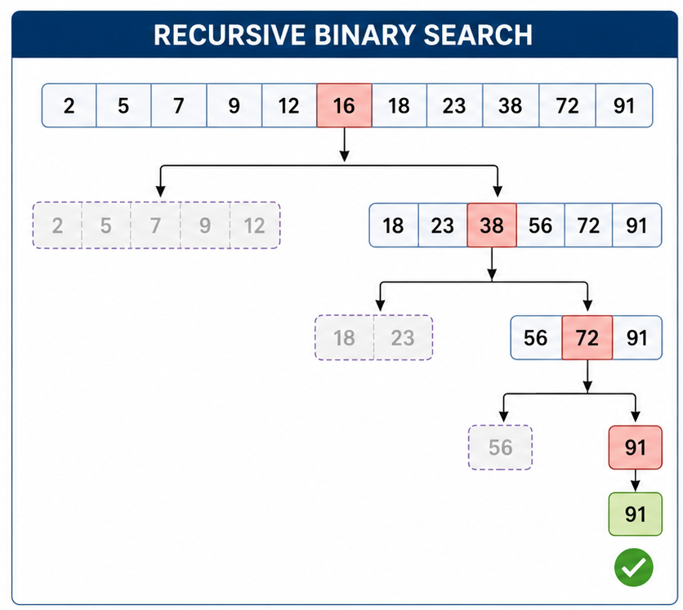
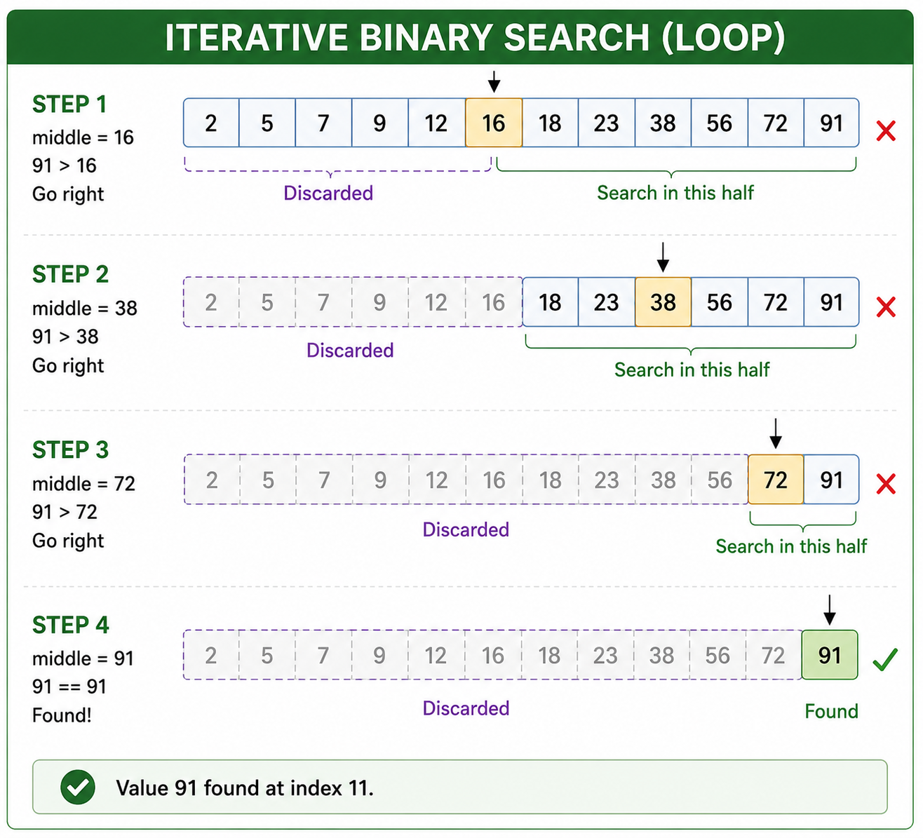
Solving Problems with Recursion – Binary Search
A problem can be solved with recursion if it can be broken down into successive smaller problems that are identical to the overall problem.
Any problem that can be solved recursively can also be solved iteratively, using a loop.
1st
last
1st
last
last
last
1st
1st
last
1st
1st
last
1st
last
1st
last

Slide 11
Recursive Binary Search Function
Algorithm
If array[middle] equals the search value, then the value is found.
Else, if array[middle] is less than the search value, perform a binary search on the upper half of the array.
Else, if array[middle] is greater than the search value, perform a binary search on the lower half of the array.

Slide 12
Recursive Binary Search Function (Cont.)
Code
int binarySearch(int array[], int first, int last, int value){
int middle;
if (first > last)
return −1;
middle = (first + last) / 2;
if (array[middle] == value)
return middle;
if (array[middle] < value)
return binarySearch(array, middle+1,last,value);
else
return binarySearch(array, first,middle-1,value);
}

Slide 13
Iterative Binary Search Function
Code
int binarySearch(int array[], int first, int last, int value){ while (first <= last){ int middle = (first + last) / 2; if (array[middle] == value) return middle; else if (array[middle] < value) first = middle + 1; else last = middle - 1; } return -1; }

Slide 14
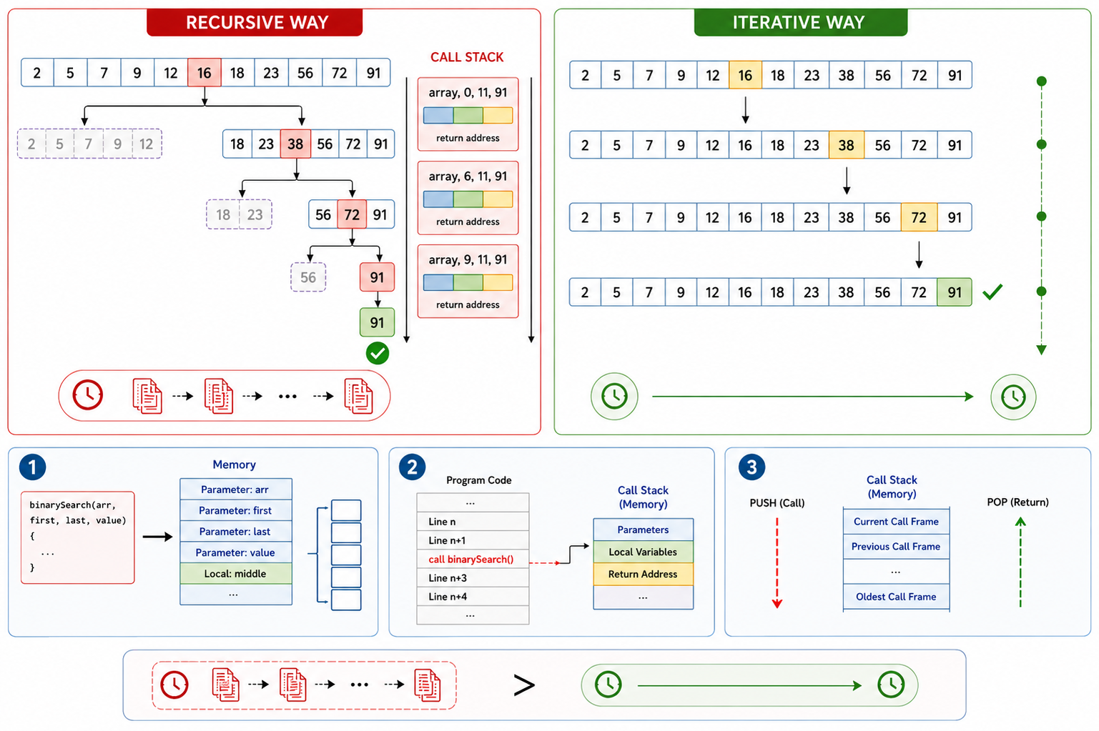
Solving Problems with Recursion (cont.)
In fact, recursive algorithms are usually less efficient than iterative algorithms.
Function calls impose overhead to the system
allocating memory for parameters and local variables
storing the address of the program location where control returns after the function terminates.

Slide 15
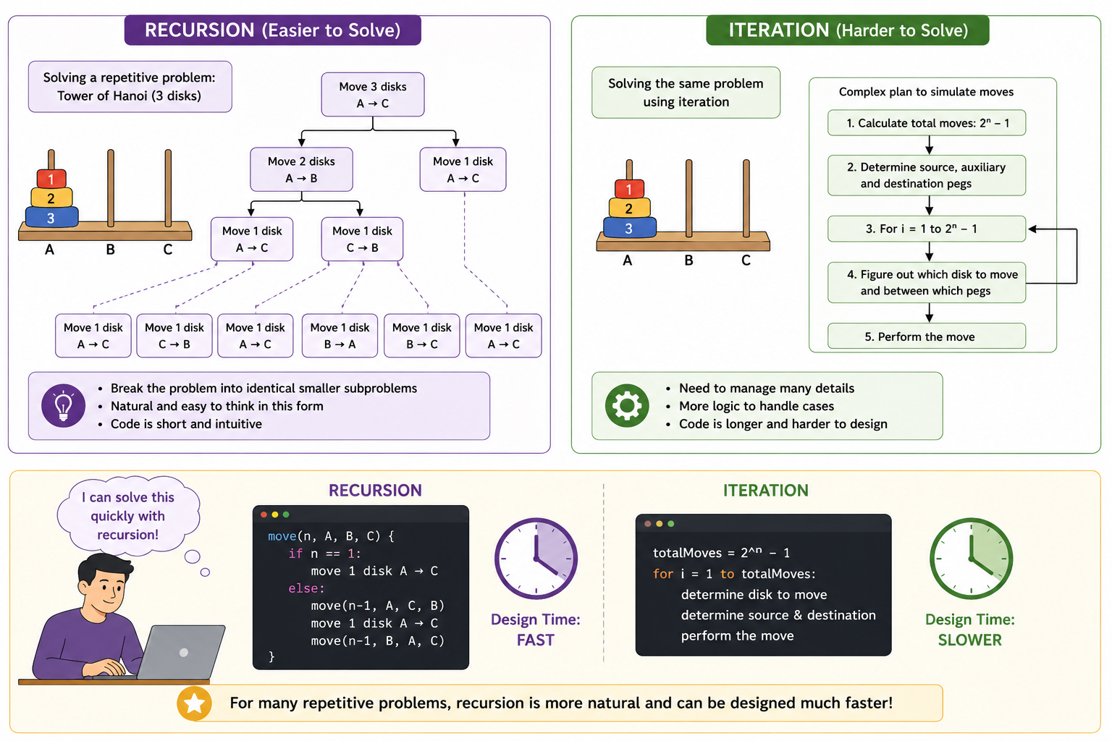
Solving Problems with Recursion (cont.)
Some repetitive problems, however, are more easily solved with recursion than with iteration.
The programmer might be able to design a recursive algorithm faster.

Slide 16
Recursion Rules
If the problem can be solved now, without recursion, then the function solves it and returns.
If the problem cannot be solved now, then the function reduces it to a smaller but similar problem and calls itself to solve the smaller problem.
Base Case: identifying at least one case in which the problem can be solved without recursion.
Recursive Case: determining a way to solve the problem in all other circumstances using recursion.
The recursive case will continue until one of the base cases are met.
What is/are the base case(s) in recursive binary search?

Slide 17
Recursion Rules
If the problem can be solved now, without recursion, then the function solves it and returns.
If the problem cannot be solved now, then the function reduces it to a smaller but similar problem and calls itself to solve the smaller problem.
Base Case: identifying at least one case in which the problem can be solved without recursion.
Recursive Case: determining a way to solve the problem in all other circumstances using recursion.
The recursive case will continue until one of the base cases are met.
What is/are the base case(s) in recursive binary search?
They are:
array[middle] == value
&
first > last

Slide 18
Recursion Types
Direct
A function calls itself
Indirect
Function A calls function B, and function B calls function A.
Function A calls function B, function B calls function c . . . and finally the last function calls function A.

Slide 19
Factorial
The factorial of a non-negative number can be defined by the following rules:
If n = 0 then n! 1
If n > 0 then n! 1  2  3  …  n
If n = 0 then factorial(n) 1
If n > 0 then factorial(n-1) 1  2  3  …  n
factorial(6) = 1  2  3  4  5  6
If n = 0 then factorial(n) = 1
If n > 0 then factorial(n) = n  factorial(n - 1)

Slide 20
Factorial (Cont.)
int factorial(int n)
{
if (n == 0)
return 1;
else
return n * factorial(n − 1);
}

Slide 21
Character Finder
int numChars(char search, string str, int subscript){
if (subscript >= str.length()) {
return 0;
}
else if (str[subscript] == search){
return 1 + numChars(search, str, subscript+1);
}
else{
return numChars(search, str, subscript+1);
}
}

Slide 22
Greatest Common Divisor (GCD)
Algorithm | Code
gcd( x , y ) = y; if y divides x evenly gcd( y , remainder of x / y ); otherwise | int gcd(int x, int y) { if (x % y == 0) return y; else return gcd(y, x % y) }

Slide 23
THANK YOU
Dr. Mohammad Ali Sarvghadi
masarvghadi@usm.my

